Slide 1
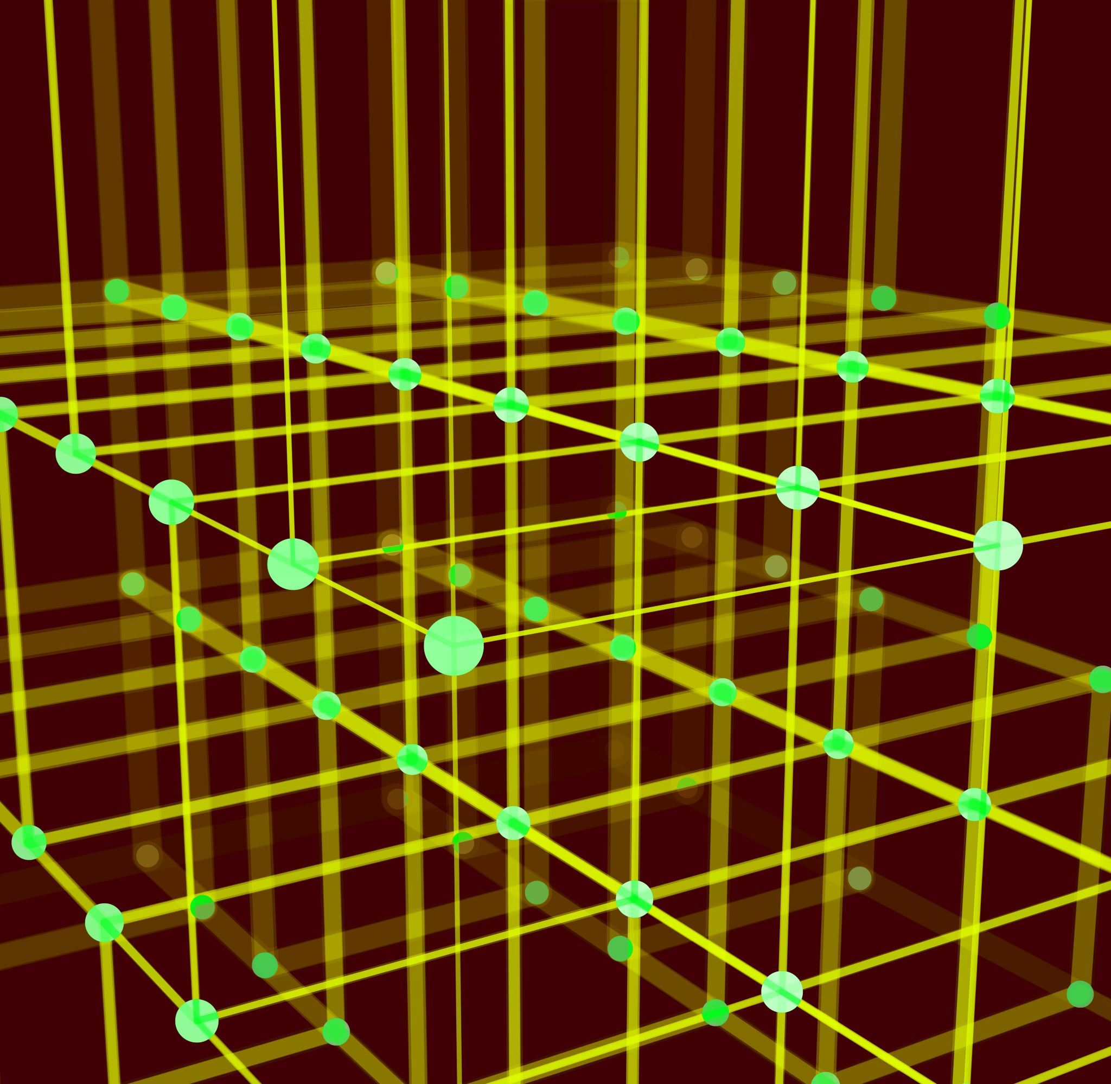
Topological Optimization with SIMP
Nathaniel Jones

Slide 2
What is Topological Optimization?
Designing structures that maximize a property
Best results for minimum material cost, weight, etc.
Multi-objective, often balancing rigidity, insulation, weight distribution

Slide 3
Who Uses Topology Optimization?
Aerospace Engineering
Household Appliance Design
Automotive Industry
& More

Slide 4
General Approaches
Finite Element Modeling
Level Set Modeling
Material placed in discrete elements
Relatively easy to formulate and solve
Quality depends on mesh resolution and type (voxel, tetrahedral, etc).
Material placed continuously
Object shape is determined by a function F(x) = 0
Highly flexible
More complicated to solve

Slide 5
SIMP Method
Solid Isotropic Material with Penalization
Finite element model designed by Martin Bendsøe and Noboru Kikuchi in 1988
Relaxes integer formulation of the problem to a continuous formulation

Slide 6
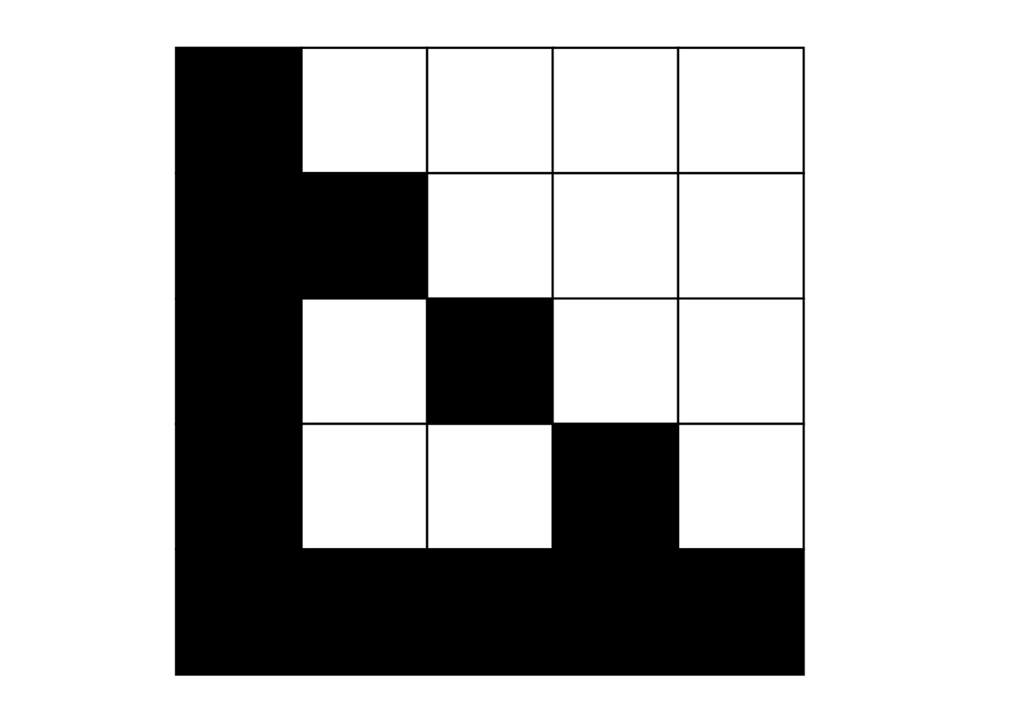
Integer Formulation

Slide 7
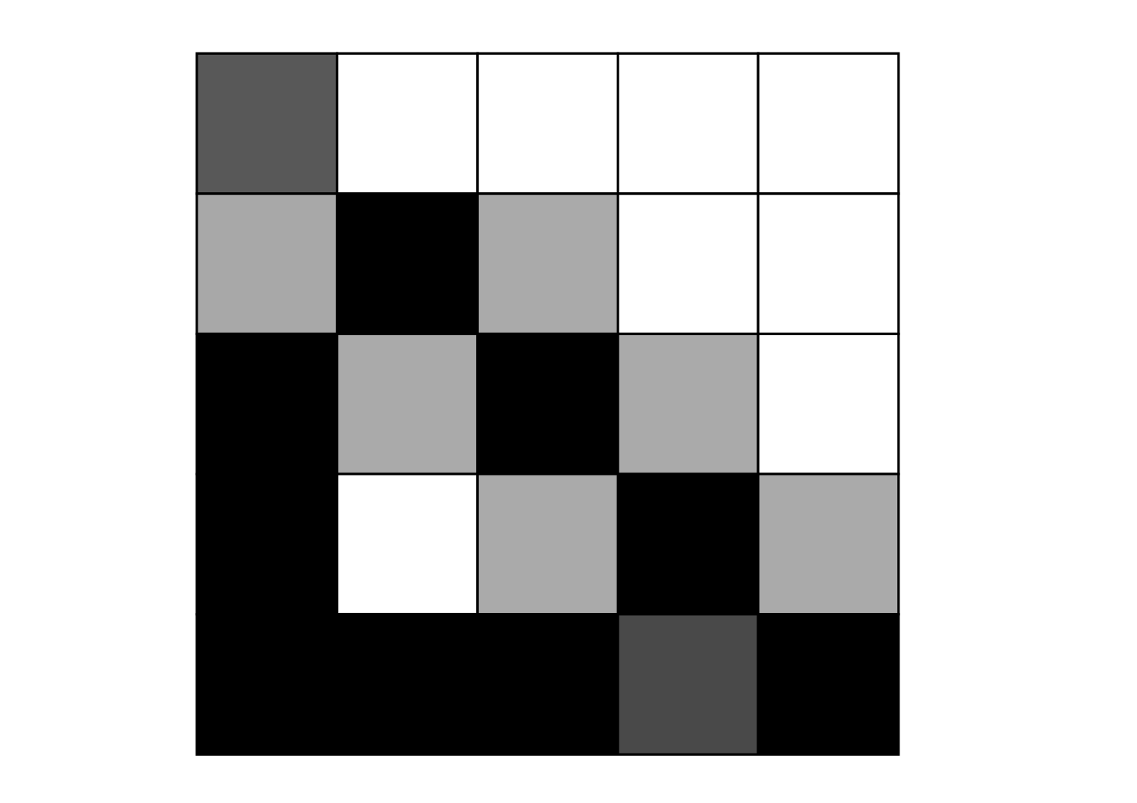
Continuous Formulation

Slide 8

Review of Linear Elasticity

Slide 9
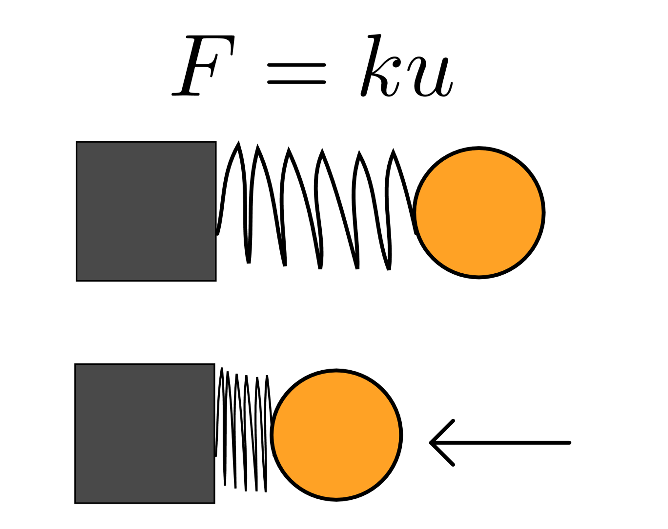
Elementary Physics
Everything is treated as a point mass
Forces act on point masses to displace them
Force and displacement are just vectors
Hooke's Law describes the displacement of a mass on a spring

Slide 10
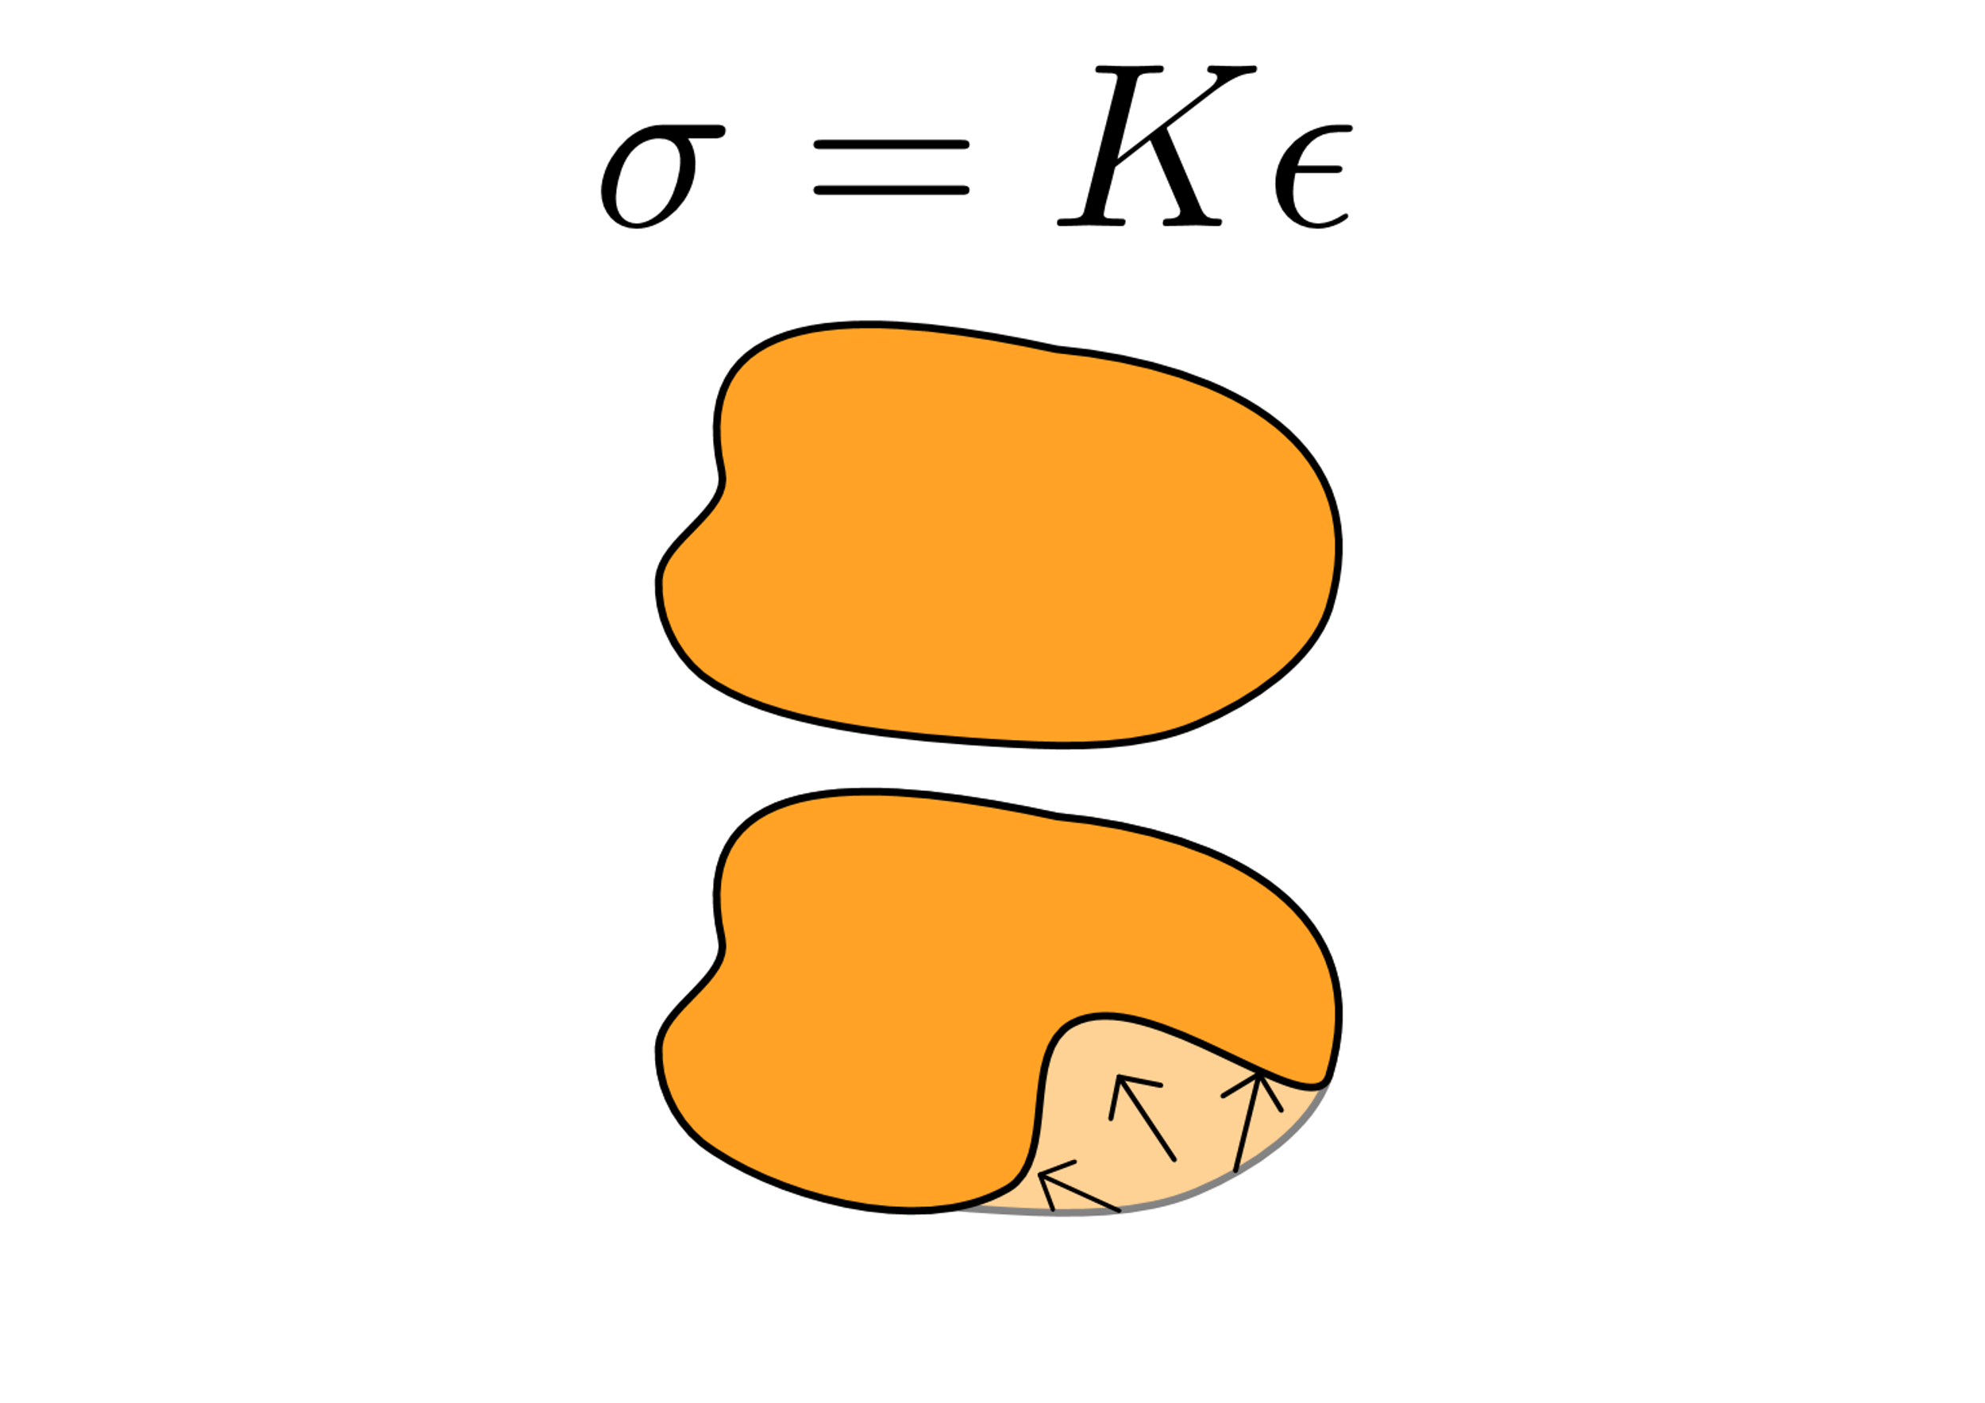
Linear Elasticity
Objects are entire volumes with a bounded region
Properties like mass, displacement, and force are functions of position
In other words, they are vector fields
Hooke's Law describes how an object resists displacement at an infinitesimal scale

Slide 11
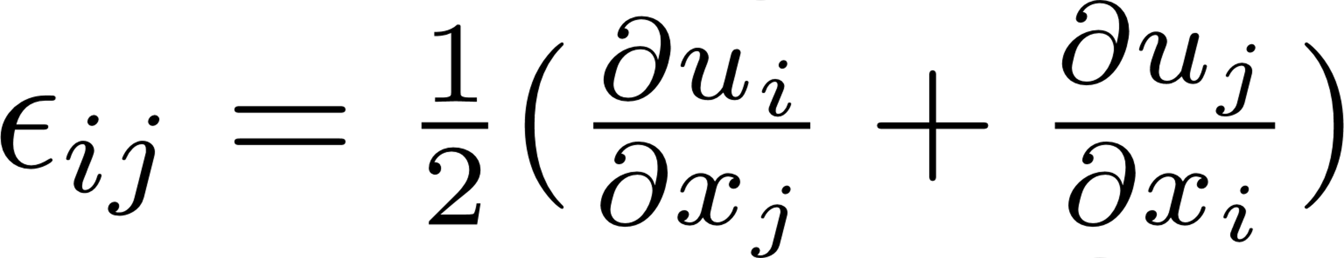
Stress & Strain
Stress Matrix σ
Strain Matrix - ε
Describes how a given point is pushed/pulled by force
Point can be pushed/pulled in multiple directions
Describes how a point is stretching/compressing
Computed as the change in displacement w.r.t position

Slide 12
Goal for the Optimization
Many things can be optimized for:
Thermal conductivity
Rigidity
Weight
+ more
Project focus is on "minimum compliance"

Slide 13
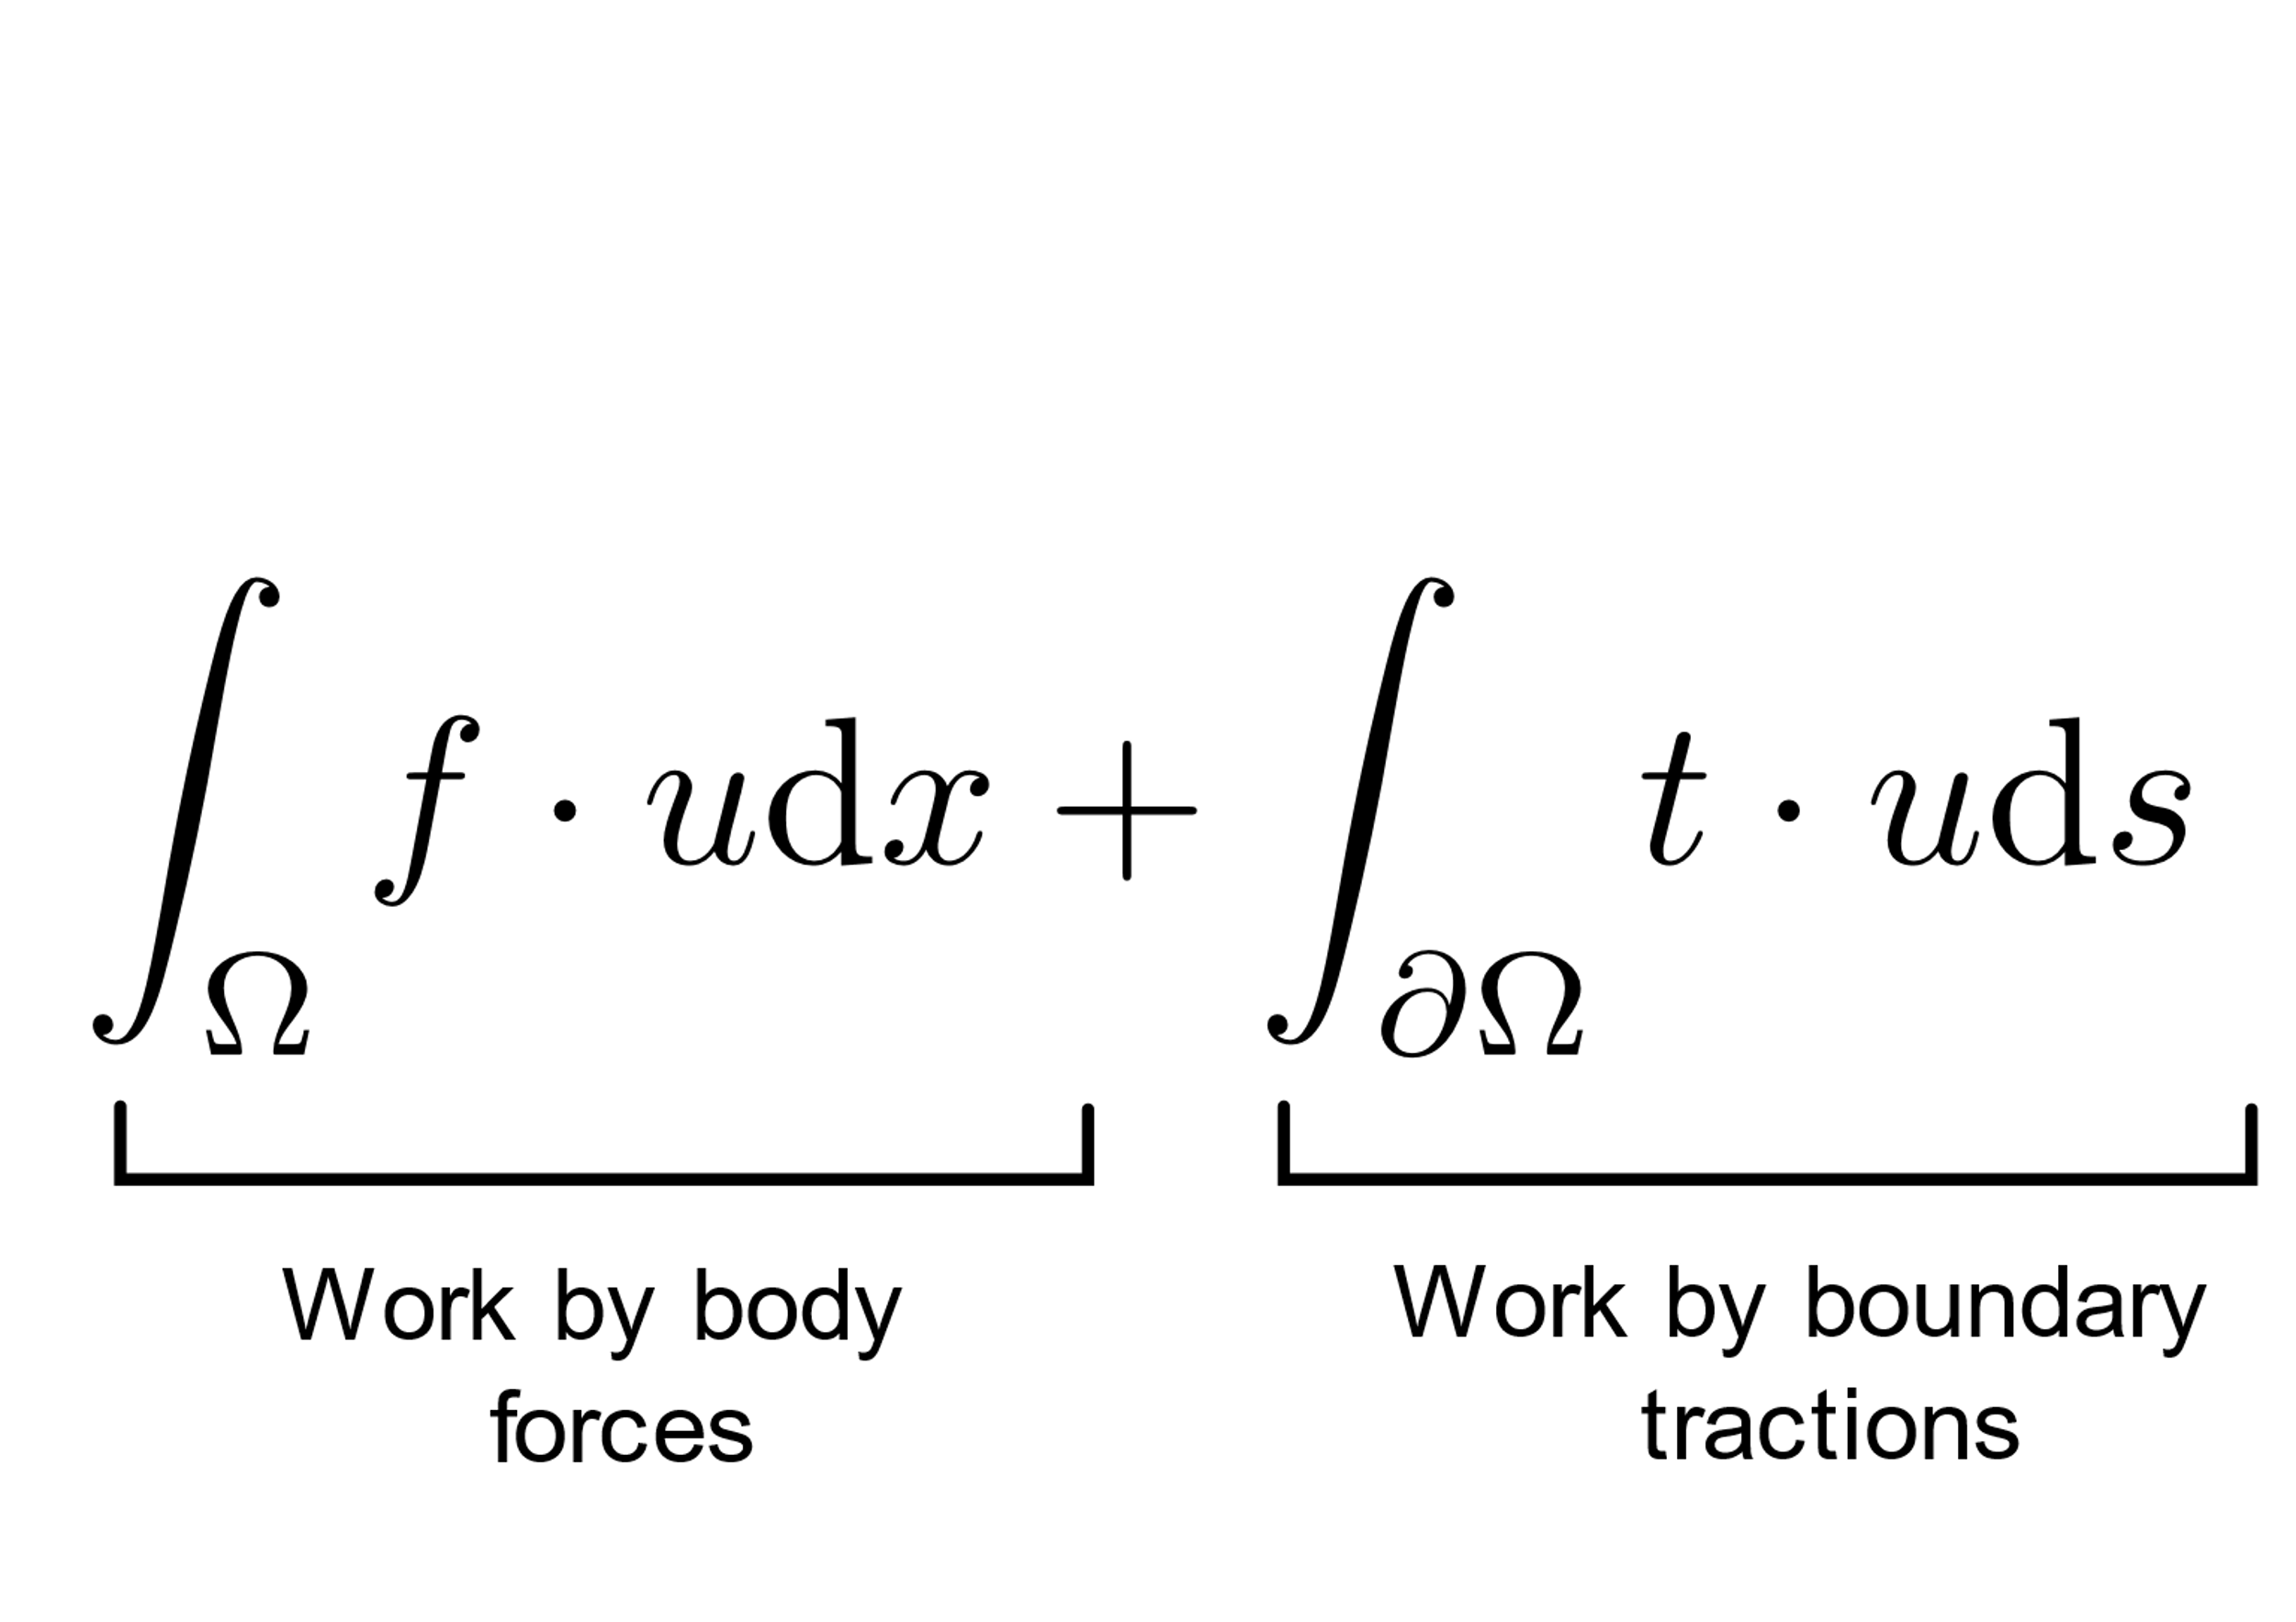
What is compliance?

Slide 14
Finding u
Unfortunately, we can't pick just any vector field
u must be physically correct!
We want the system to be in elastic equilibrium

Slide 15
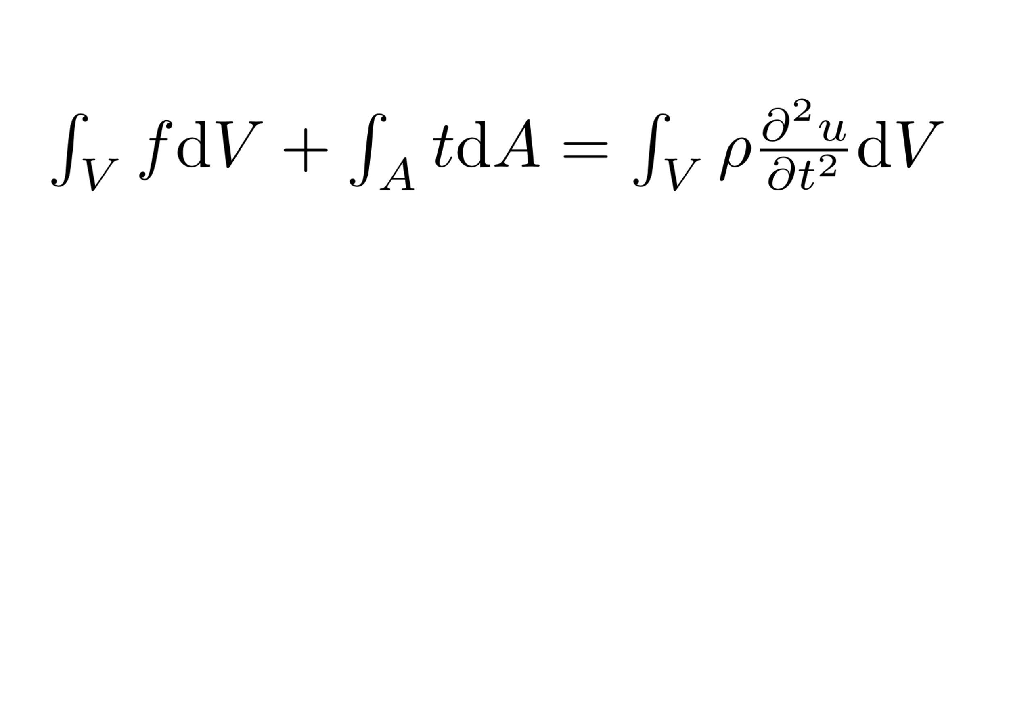
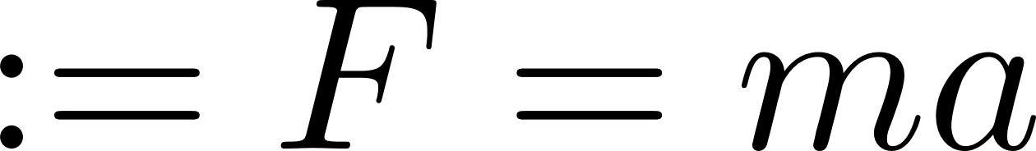
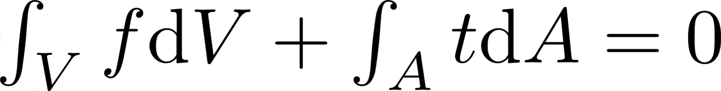
Strong Form of Equilibrium

Slide 16
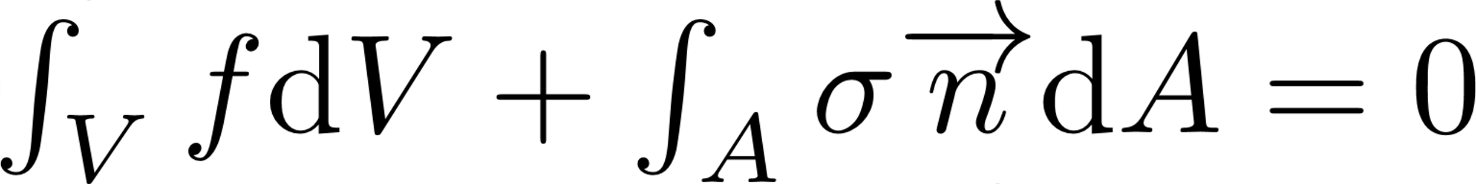
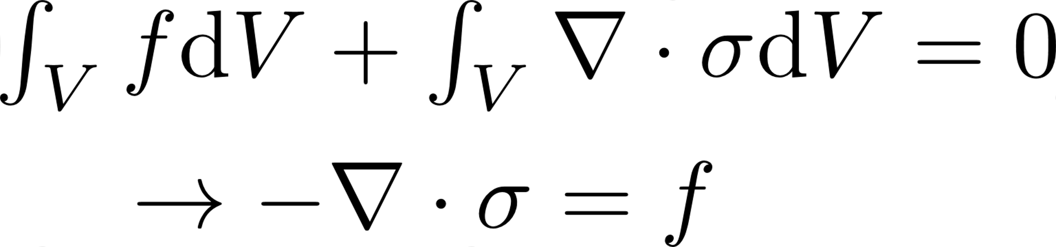
Strong Form of Equilibrium
(Divergence Theorem)

Slide 17
Strong Form of Equilibrium

Slide 18
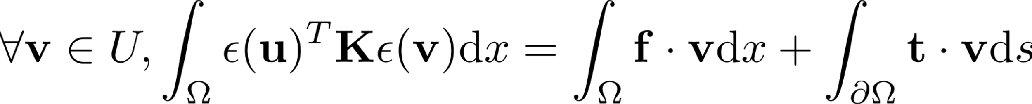
Weak Form of Equilibrium

Slide 19
Summary
Objects are deformable volumes
Stress and strain are related by Hooke's Law
The displacement field is the center of everything
We want the deformation to result in equilibrium

Slide 20
The SIMP Model

Slide 21
The SIMP Model
As stated before, SIMP is a finite element model
We control displacement by controlling element stiffness
Stiffness is controlled by altering element density

Slide 22


Slide 23
What's this p?
P is the penalty factor
We want there to either be material or no material in each element
How do we even manufacture intermediate material?

Slide 24
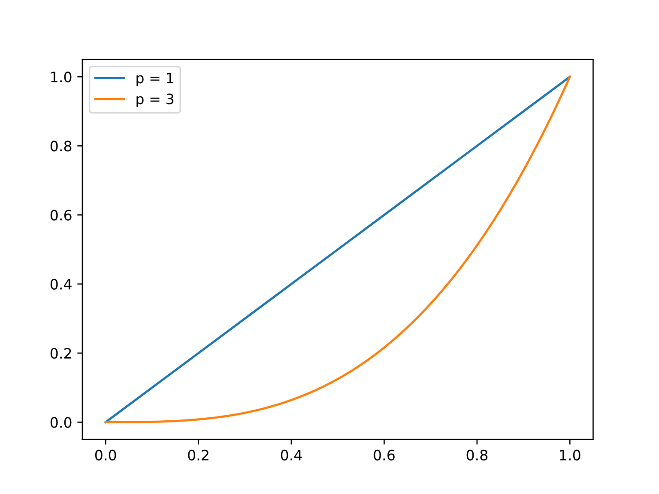
Stiffness Curve

Slide 25
SIMP Assumptions
Material is isotropic (resists stretching the same in all directions)
Loads are only mechanical (not thermal or otherwise)
Loads are static
In this project, body forces are negligible compared to traction (loads)

Slide 26
Finding the Optimal Topology

Slide 27
Finite Element Formulation
For this project, we use square elements
Each node's (vertex's) stiffness is contributed to by the 4 elements surrounding it

Slide 28

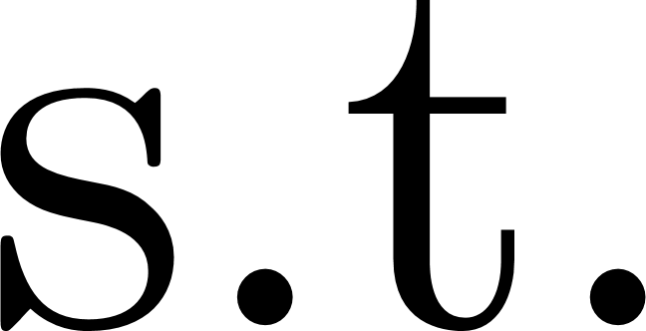
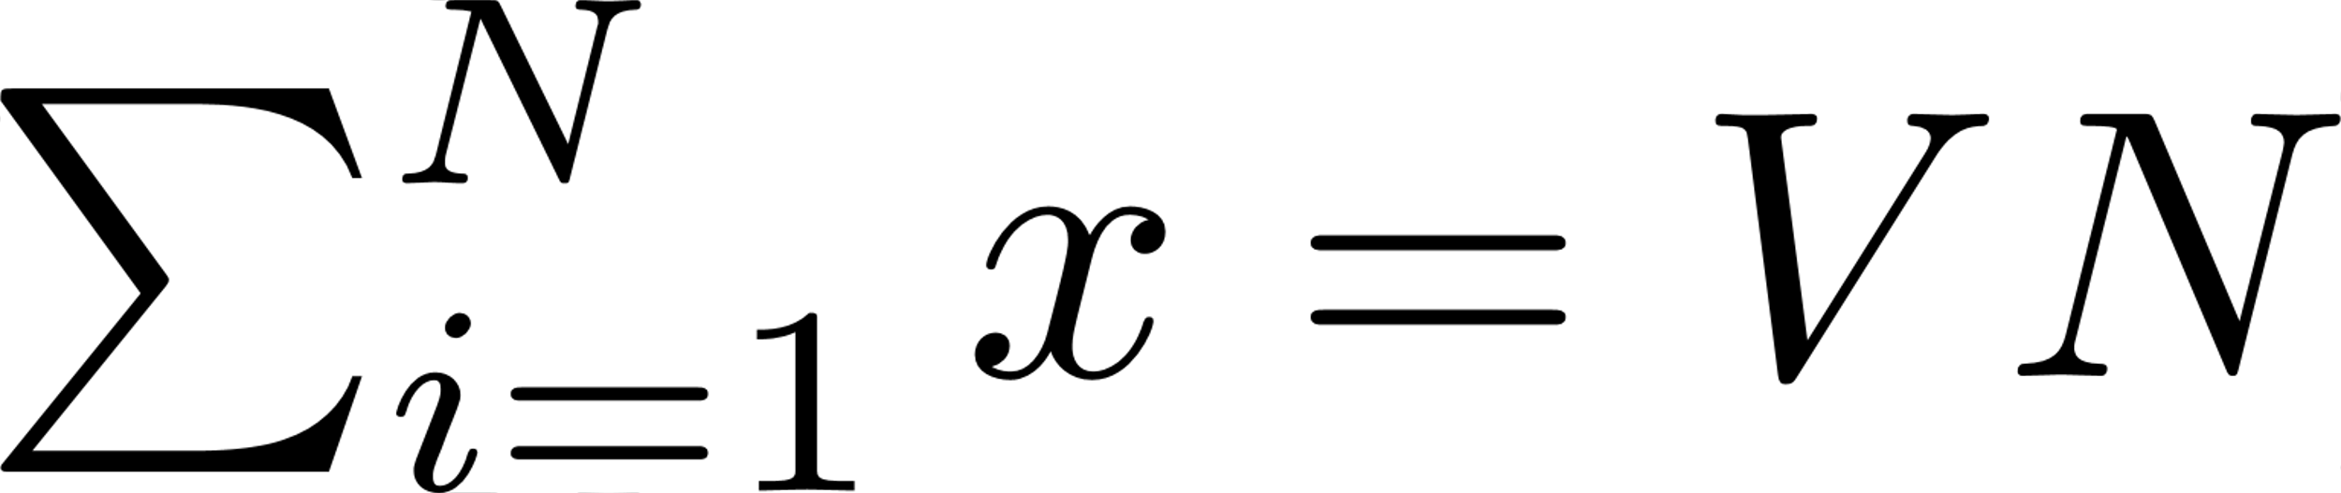
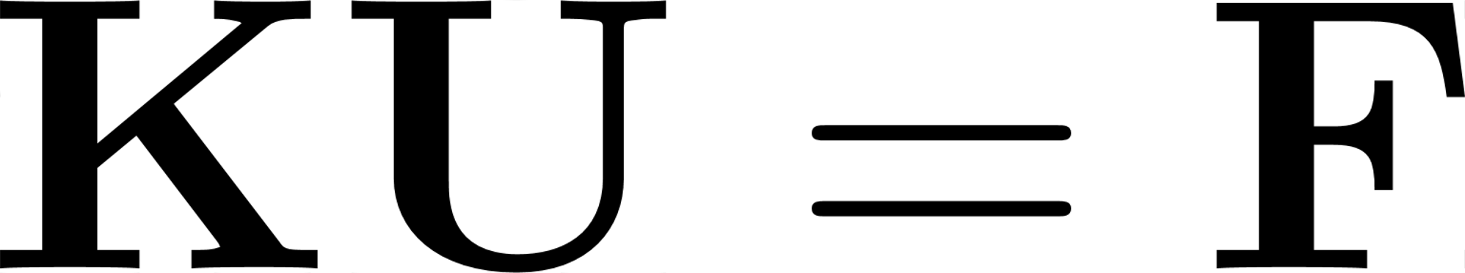
Problem Statement

Slide 29
Hooke's Law Constraint
Finding a true, continuous displacement is hard
But we don't have to!
Each node is basically a point mass on a spring (or four)
Described with a simple linear system

Slide 30
Volume Constraint
We want to use at most a certain amount of material
Fraction of volume is a dimensionless parameter

Slide 31
Objective Function
We can directly control the objective through K

Slide 32
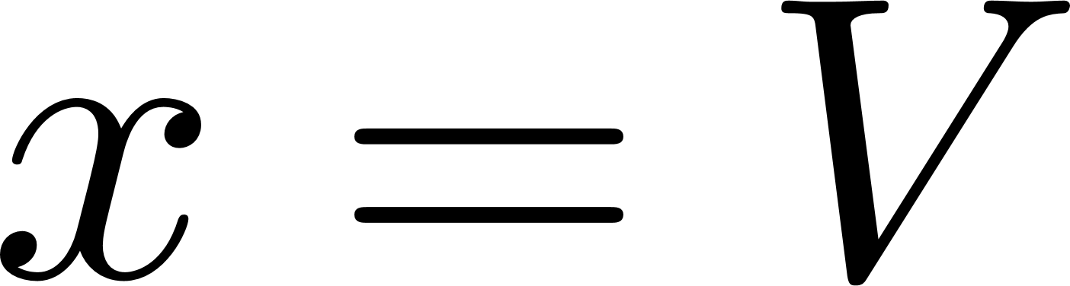

Optimization Strategy
Algorithm looks like this:
Start with for all elements
Solve
Maximize for the solved displacement
Repeat II and III until stopping criteria

Slide 33
Wait, maximize?
Yes, maximize!
Displacing the object should require a lot of work

Slide 34
Model Analysis

Slide 35
Parameter Sensitivity
The model has various parameters:
Volume fraction
Amount of load
Load positions
Support positions
Penalty factor
Inherent stiffness (elastic or "Young's" modulus)

Slide 36
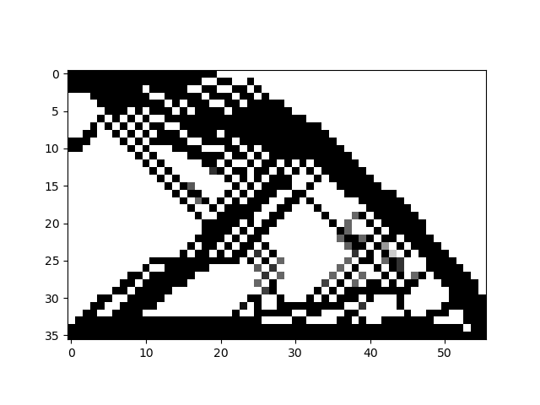
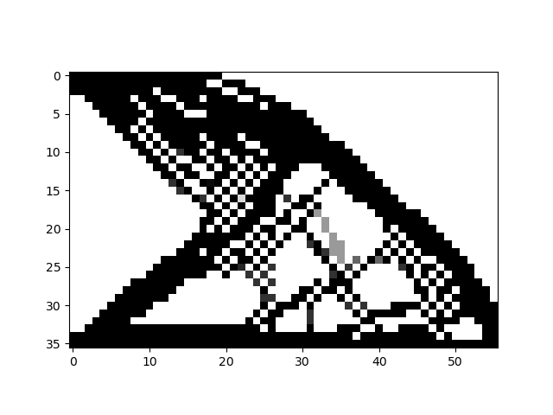
Cantilever Beam at Various Penalties
Penalty = 3.0, Volume = 0.4
Penalty = 3.2, Volume = 0.4

Slide 37
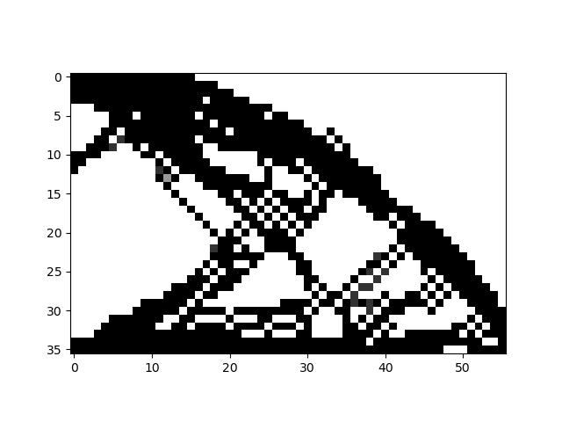
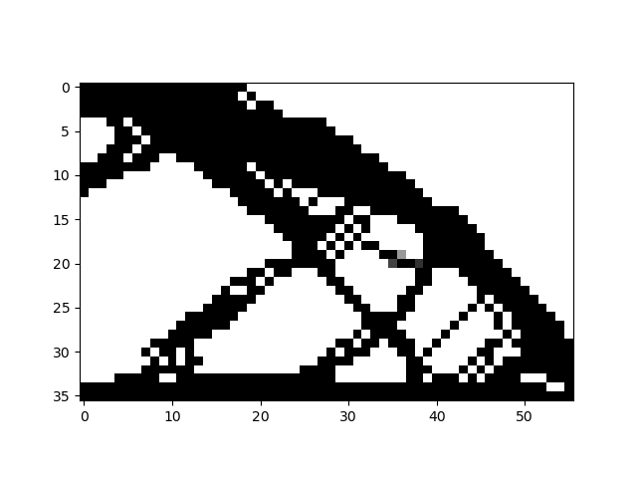
Cantilever Beam at Various Penalties
Penalty = 3.6, Volume = 0.4
Penalty = 4.0, Volume = 0.4

Slide 38
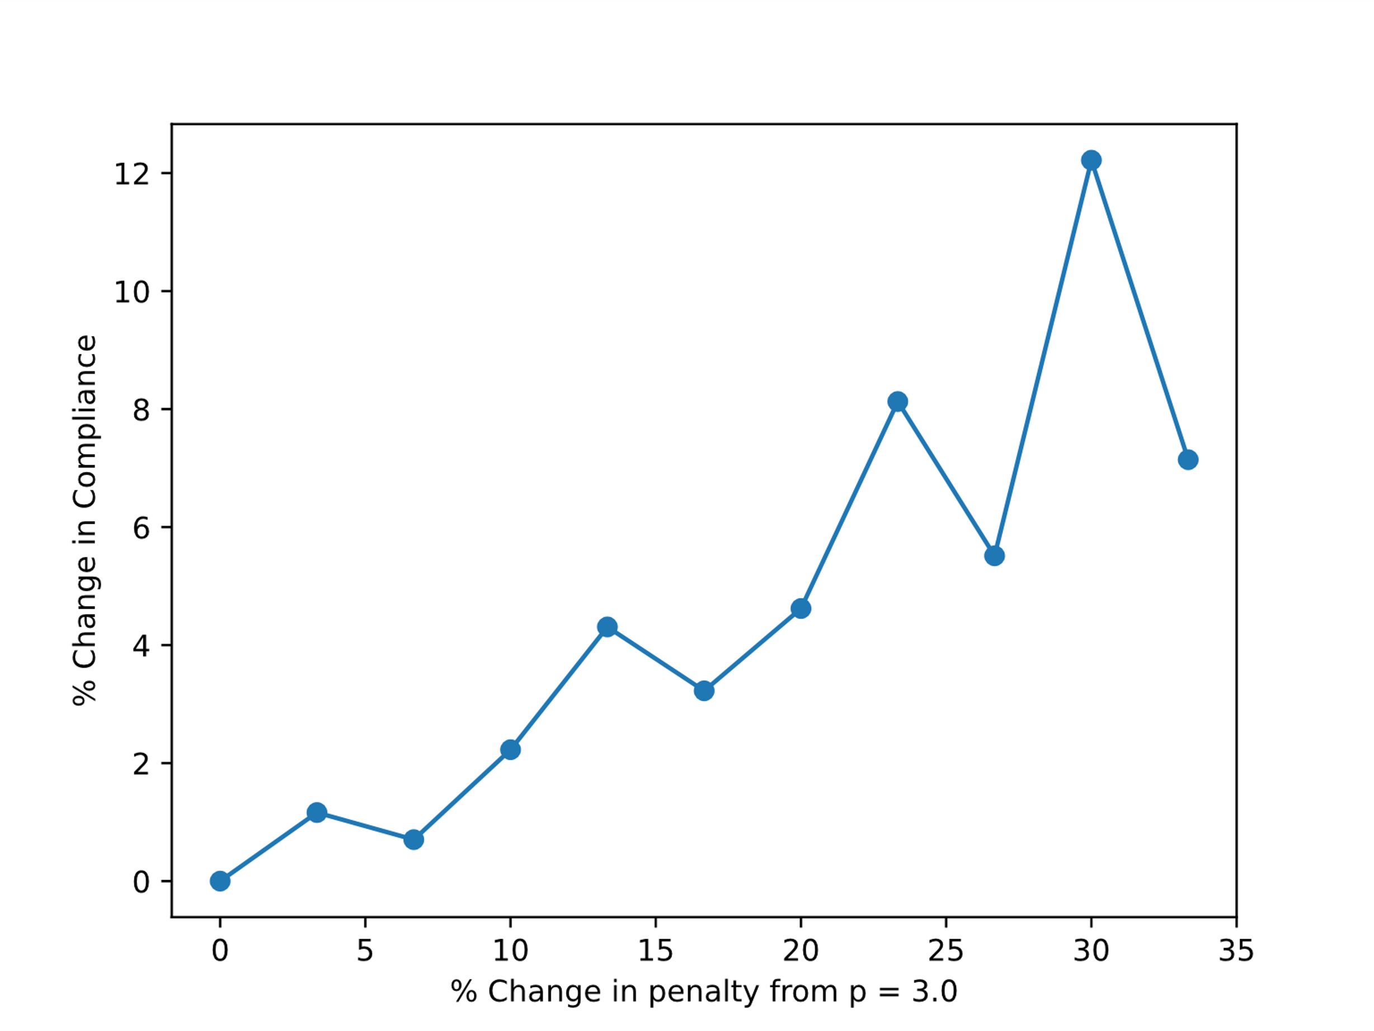
Compliance Sensitivity to Penalty

Slide 39
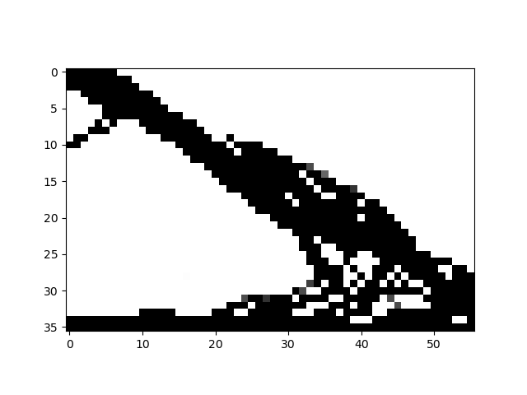
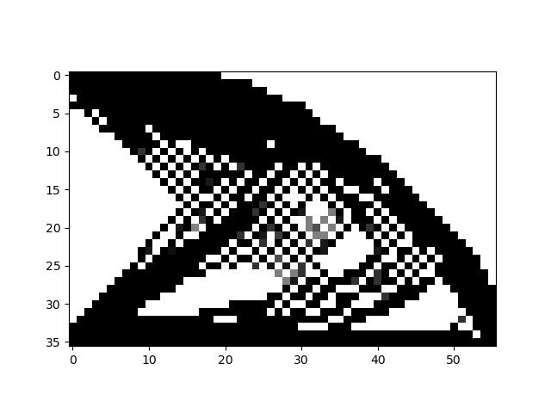
Cantilever Beam at Various Volumes
Penalty = 3.0, Volume = 0.3
Penalty = 3.0, Volume = 0.5

Slide 40
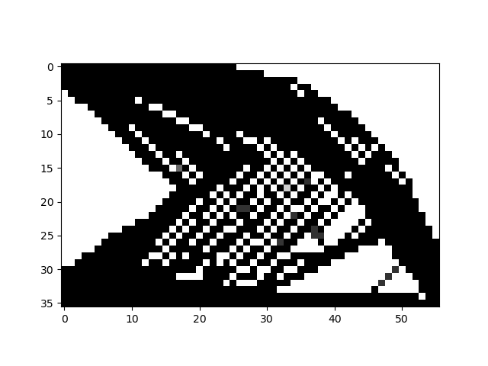
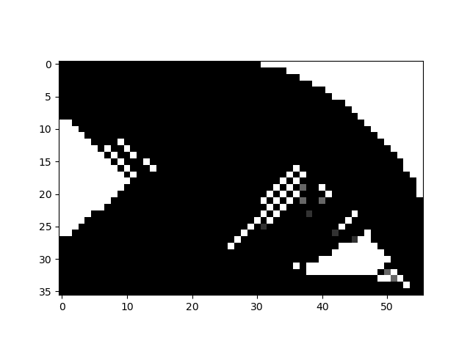
Cantilever Beam at Various Volumes
Penalty = 3.0, Volume = 0.6
Penalty = 3.0, Volume = 0.8

Slide 41
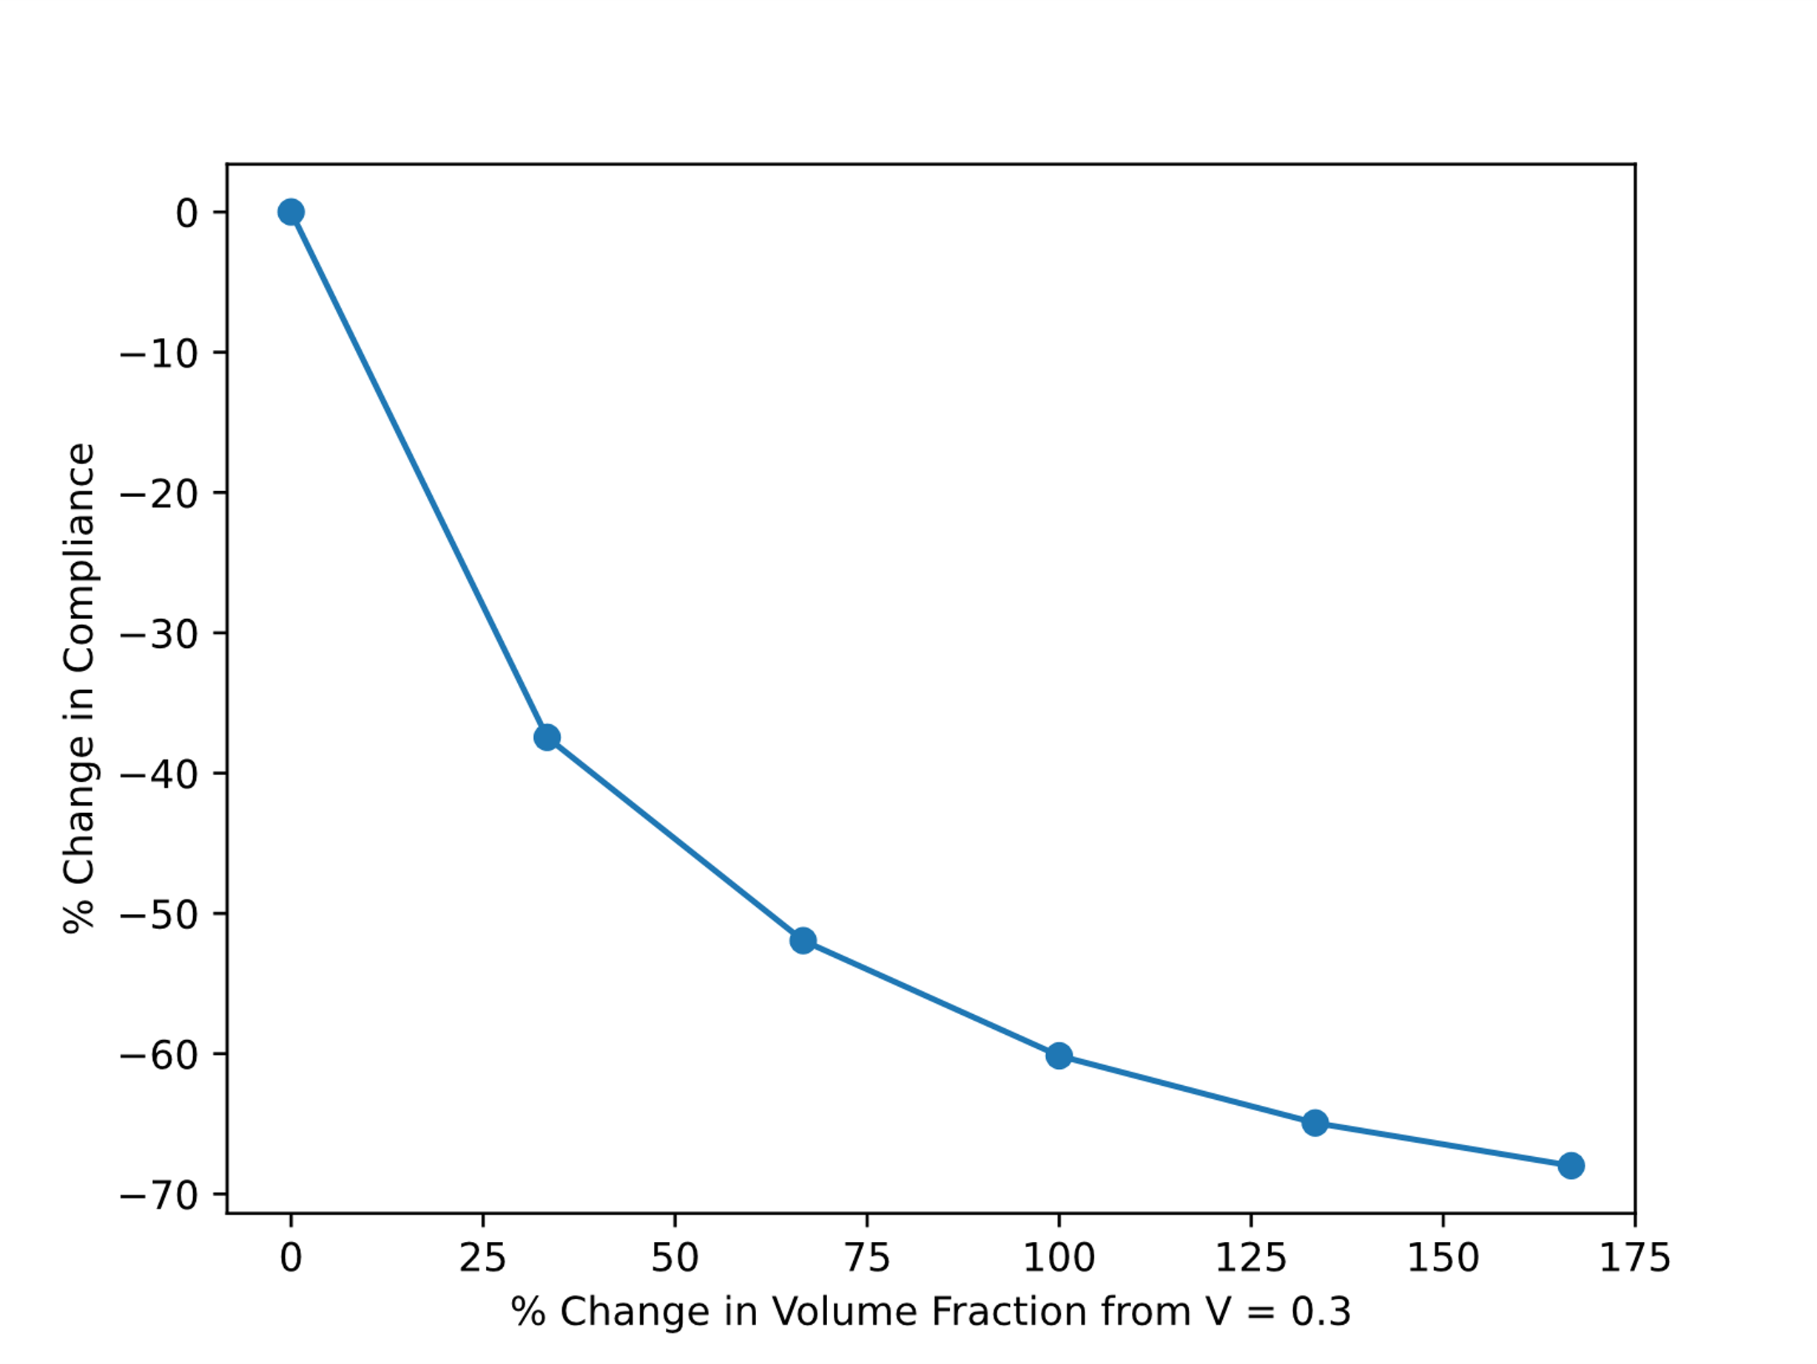
Compliance Sensitivity to Volume

Slide 42
Intermediate Densities
In the optimal topology there are gray elements
This means that there is "some" material here
How do we think about this?

Slide 43
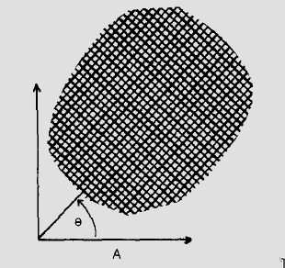
Infinitesimal Pores
Bendsøe proposed porous materials as a possible interpretation
Optimal shape determination is framed as a "sizing" problem
SIMP is deciding how big to make the pores
(Bendsøe 1989)

Slide 44
Conclusion

